Slide 1


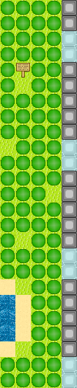
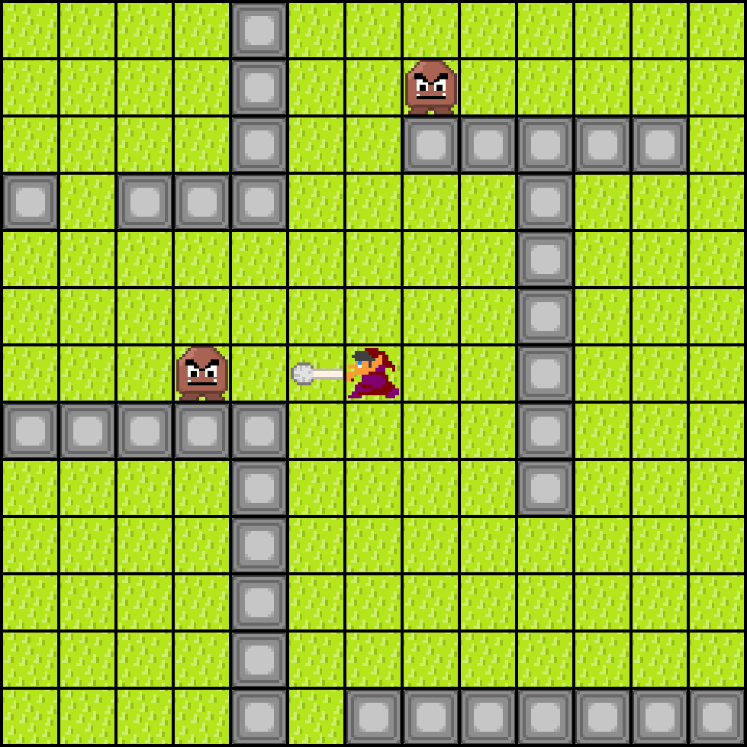
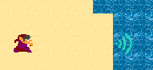
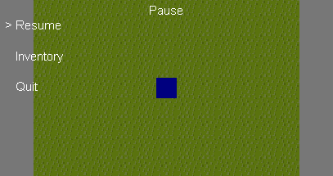
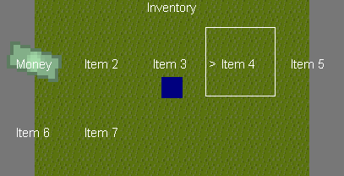
Tile-Based RPG
Name: Thomas Wenham. Supervisor: Joseph Walton-Rivers
Features
Tile-based RPG (role playing game)
The game is played on a freely explorable grid-based world – meaning game characters can only move in cardinal directions – and viewed from a top-down perspective.
The player has access to a range of abilities with which to defeat enemies – using different equipment, they can use short and longer range attacks with different effects.
Enemies have artificial intelligence that allow them to navigate the world and fight the player effectively.
There are items in the world that the player can collect. They can view/use/equip their items in the Inventory.
Custom system for loading level data from a text file
Custom game engine and modularity allows easy expansion
Menu system written with tree structure – each part has child branches. Each node can act as sub-menus.
Inventory is a menu that shows your held items.
Written from scratch in Java; no game engine or external libraries
Swing used for Graphics
Grid based world
The game primarily consists of game objects that take a place on the grid
Collisions modelled by attempt for two objects to occupy same space
Hitboxes (collisions outside of objects, used for attacks) and Items are decoupled from grid so they can occupy same space as an object.
Basic Game loop:
Handle pause actions, such as the menu
Handle user input
Update each game object
Handle object interactions
Re-draw to screen
*Screenshots may not be representative of actual gameplay

